Slide 1

Traffic Flow Analysis Tool
Course SE 801
Software Project Lab III
Project Proposal
Submitted By
Saif Kamal Chowdhury
BSSE0924
Supervised By
Dr. Naushin Nower
Associate Professor Institute of Information Technology, University of Dhaka

Slide 2
TOC
Motivation
Project Overview
Quality Function Deployment
Tools and Technologies
Timeline

Slide 3
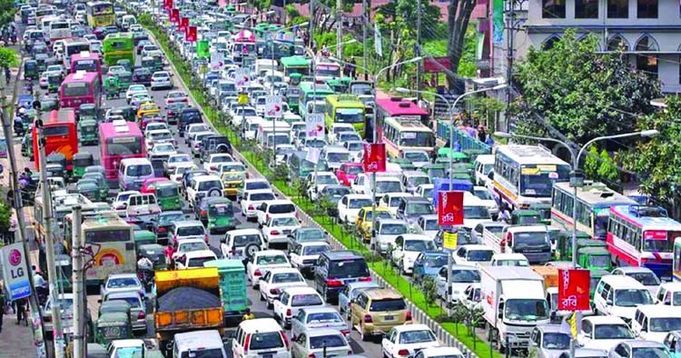
Motivation
No viable source of data related to traffic to generate analytical result for the roads of Bangladesh
Most methods require expensive sensors or equipments
Unable to understand which roads need infrastructural changes to reduce traffic congestion
Get the best time and route to travel to an specific area

Slide 4
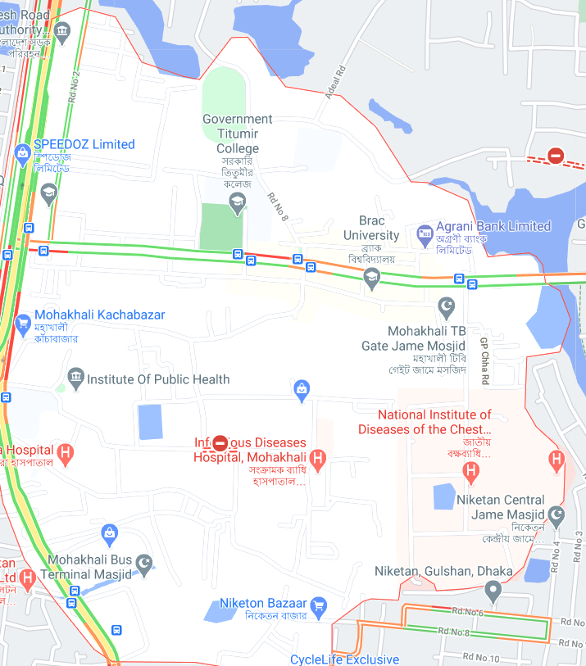
Project Overview
A system to provide analytical data on traffic flow in a specific area. Predict traffic intensity of an area at a given date and time.
01 | Image Data collection
02 | Image processing
03 | Generate textual data
04 | Generate Output Analysis

Slide 5
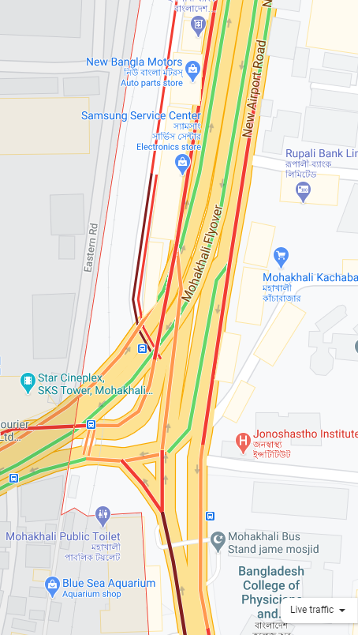
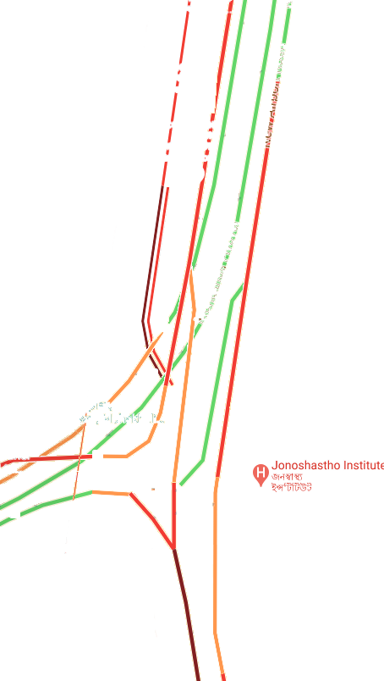
Example of Image Data processing
Red : Heavy traffic.
Orange : Medium-near heavy traffic.
Yellow :Medium traffic.
Green: less traffic or no traffic
Factors:
Intersections
Institution presence(e.g - marketplace, hospital etc)
Bus Routes

Slide 6
Quality Function Deployment
Normal Requirements
1
Generate analytical data of traffic flow in a specific area
2
Graphical result of analysis
Expected Requirements
1
The system should be user friendly.
2
Time to generate output should not be much
Exciting Requirements
1
Predict traffic flow in a specific area on a given date and time.

Slide 7
Tools and Technologies
Image data collection
Selenium webdriver with python
Image processing and analysis
OpenCV,PIL, Python
Desktop application
.NET based desktop app

Slide 8
Timeline
Weeks
Requirement Analysis
Data Collection
Implementation
Testing and bug-fixing
Result Analysis
Documentation
1 | 2 | 3 | 4 | 5 | 6 | 7 | 8 | 9 | 10 | 11 | 12

Slide 9
Thank you.

